Slide 1
Adv. Biopharmaceutics
Dr. Mohammed Sabbar
College Of Pharmacy - Basrah
3rd Oct. 2018
http://bit.do/ex2aD

Slide 2
RATE-LIMITING STEPS IN DRUG ABSORPTION of IMMEDIATE RELEASE
Dissolution-Poor soluble drugs
Disintegration

Slide 3
RATE-LIMITING STEPS IN DRUG ABSORPTION of IMMEDIATE RELEASE
Dissolution-Poor soluble drugs
Disintegration (ICH Q6A guidelines are met)
The product under consideration is rapidly dissolving (dissolution >80% in 15 minutes at pH 1.2, 4.0, and 6.8);
(2) the drug product contains drugs that are highly soluble throughout the physiological range (dose/solubility volume <250 mL from pH 1.2 to 6.8);
(3) a relationship to dissolution has been established or when disintegration is shown to be more discriminating than dissolution and dissolution characteristics do not change on stability.

Slide 4
Dissolution and Solubility

Slide 5
Dissolution and Solubility
Noyes and Whitney (1897)
where dC/dt = rate of drug dissolution at time t,
D = diffusion rate constant,
A = surface area of the particle,
Cs = concentration of drug (equal to solubility of drug) in the stagnant layer,
C = concentration of drug in the bulk solvent, and
h = thickness of the stagnant layer.

Slide 6
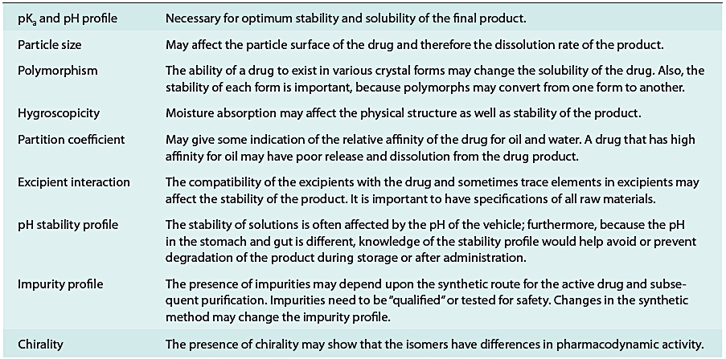
PHYSICOCHEMICAL PROPERTIES OF THE DRUG

Slide 7
Thank you

